Slide 1
3-IBFE 3D Flow Past Objects

Slide 2
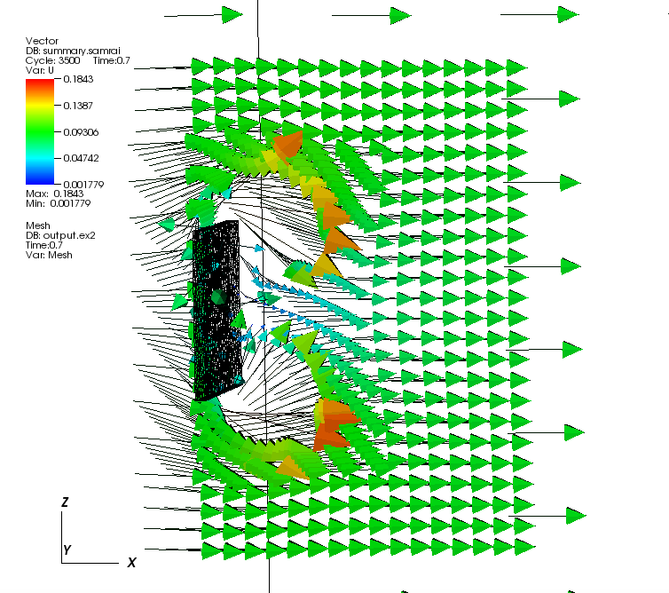
Goal
Create a plate in a 3D flow tank.
Let the plate be tethered along its centerline.
Move the flow from left to right along x-axis.
See example 3-IBFE-Example_FlowTank-MidPlate.

Slide 3
Strategy for domain and plate dimensions
In this example, the domain is 32x16x16 units.
The domain goes from -16<x<16, -8<y<8, -8<z<8.
dx = 16/256 = 0.0625.
Make a plate that is 0.125 x 2 x 2 units.
Previously, we translated the plate to the left. That feature is not working as it used to in newer versions of IBAMR.

Slide 4
Step 1: Make the mesh in gmsh
The resulting file should be similar to plate2.msh in the Example folder.
Remember that we want the element size to be about dx=0.0625.
We can make this by making a square and then extruding it into the third dimension.

Slide 5
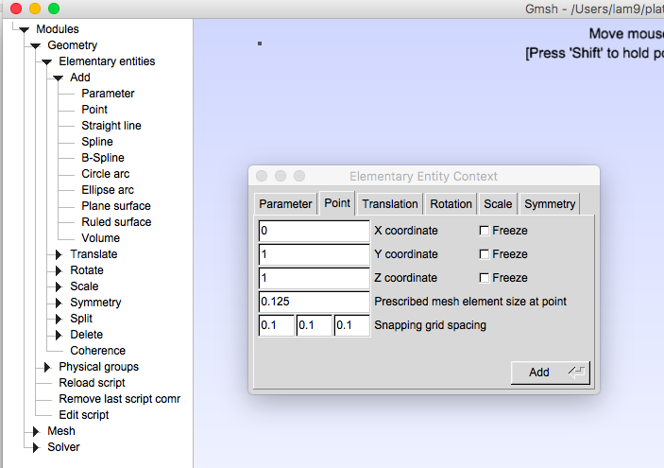
Open gmsh, then File-> new
Go to Geometry-> Elementary entities -> Add -> Point
Make points at (0,1,1), (0,-1,1), (0,-1,-1) and (0,1,-1) with Prescribed mesh element size set to 0.0625.
Click Add for each point.

Slide 6
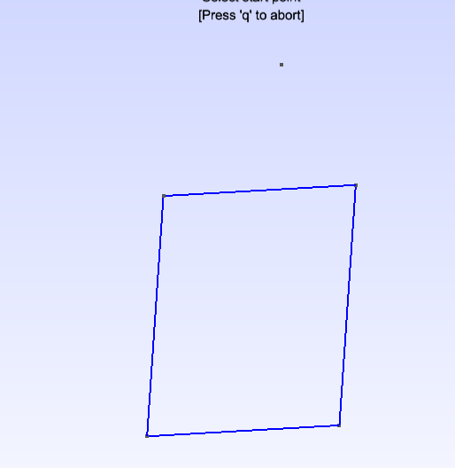
Connect the points with lines
Go to Geometry-> Elementary entities-> Add-> Straight Line
Left click one point and then the next to make a line.
Repeat for all 4 sides.
Left click and drag to rotate the image in 3D.

Slide 7
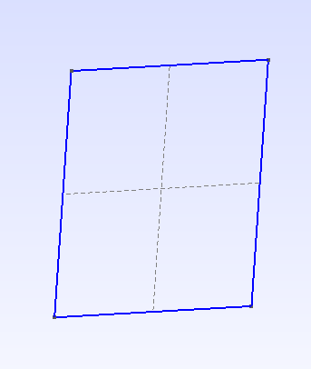
Make a surface from the square
Geometry-> Elementary entities -> Add->Plane Surface
Left click a line to illuminate the hole square.
Press e to end selection.
A grid should appear over the plane.

Slide 8
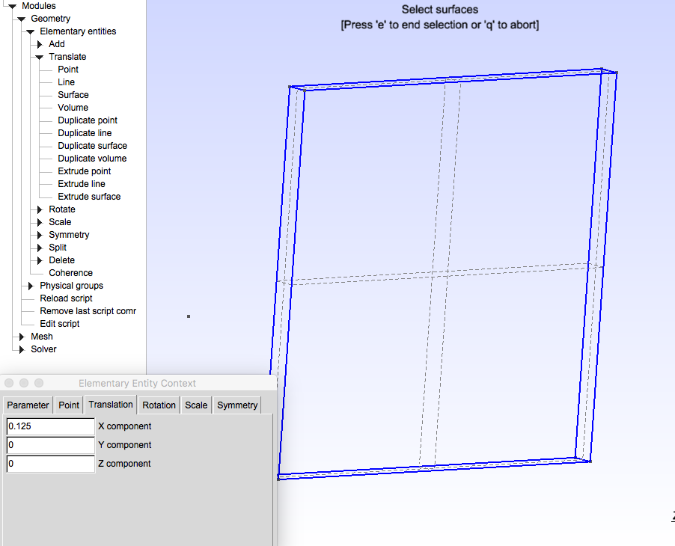
Extrude to 3D plate
Geometry-> Elementary entities -> Add -> Translate -> Extrude surface
Extrude 0.125 in x-direction.
Left click grid so it’s red.
Press e to end.
This will make plate 2 elements thick.

Slide 9
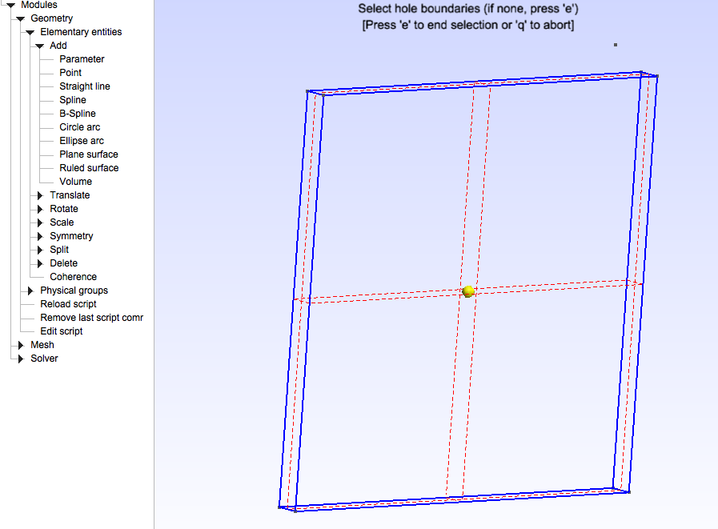
Make a volume in the frame
Geometry-> Add -> Elementary entities -> Add -> Volume
Select dashed grid lines so the glow red, click e to end.

Slide 10
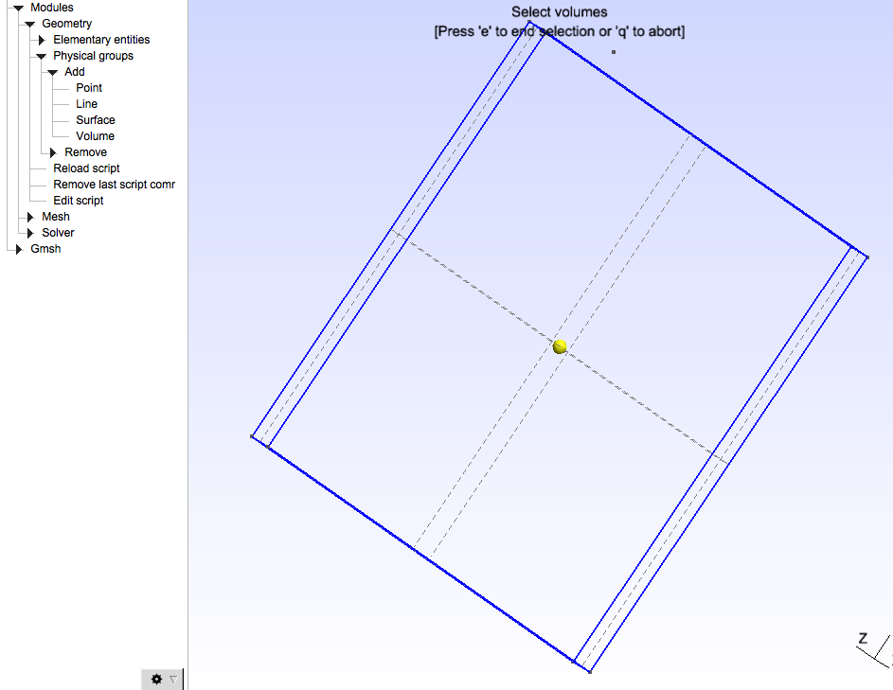
Add a physical group that is the volume
Geometry->Physical Groups -> Add -> Volume
In the popup box, name your mesh and use automatic numbering.
Left click the yellow dot in the middle of box.
Press ‘e’ to end.

Slide 11
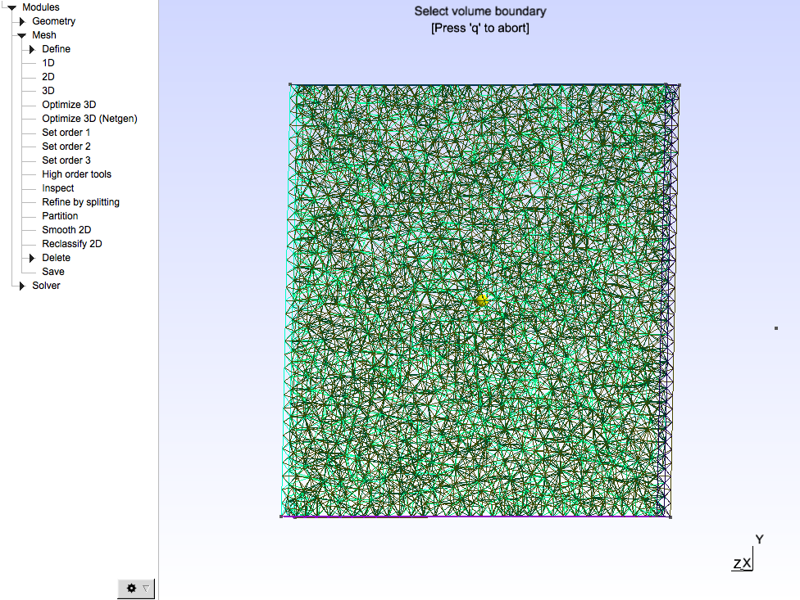
Make the mesh
Mesh -> 3D
File -> save mesh
The above will save the mesh of the physical group as group_name.msh. This leaves only the 3D mesh and no 1D or 2D meshes that libmesh will reject.

Slide 12
input3d
In this example, the mesh name is given in both the input3d file and the main.C file.
Re is modified by updating the viscosity accordingly.
Flow ramps up from 0 m/s at t = 0 and moves in the x-direction.

Slide 13
main.C- Target forces
Apply target force at the midline of plate using target_force_function. Applied in band running from -.1 to .1 in z-direction.
voidtarget_force_function(
VectorValue<double>& F,
const TensorValue<double>& /*FF*/,
const libMesh::Point& X,
const libMesh::Point& s,
Elem* const /*elem*/,
const std::vector<const std::vector<double>*>& /*var_data*/,
const std::vector<const std::vector<VectorValue<double> >*>& /*grad_var_data*/, double time,
void* /*ctx*/)
{

Slide 14
main.C- Target forces
libMesh::Point s_dump;
double kappa;
s_dump = s;
// apply tether force only if z-coordinate of original position is within 0.1 of center.
if (abs(s(2)) < .1)
{
kappa = kappa_s;
}
else
{ // no tether force, set tether stiffness to zero.
kappa = 0;
}
F = kappa * (s - X); // Note x is actual position, s is desired position
return;
}

Slide 15
main.C - stress tensor functions
void PK1_dev_stress_function(
TensorValue<double>& PP,
const TensorValue<double>& FF,
const libMesh::Point& X,
const libMesh::Point& s,
Elem* const /*elem*/,
const std::vector<const std::vector<double>*>& /*var_data*/,
const std::vector<const std::vector<VectorValue<double> >*>& /*grad_var_data*/,
double time,
void* /*ctx*/)
{
double mu;
mu = mu_stem;
PP = (mu)*FF;
return;
} // PK1_dev_stress_function

Slide 16
main.C - stress tensor functions
Void PK1_dil_stress_function(
TensorValue<double>& PP,
const TensorValue<double>& FF,
const libMesh::Point& X,
const libMesh::Point& s,
Elem* const /*elem*/,
const std::vector<const std::vector<double>*>& /*var_data*/,
const std::vector<const std::vector<VectorValue<double> >*>& /*grad_var_data*/,
double time,
void* /*ctx*/)
{
double mu;
double beta;
mu = mu_stem;
beta = beta_stem;
PP = (-1.0*(mu)+beta*log(FF.det()))*tensor_inverse_transpose(FF,NDIM);
return;
} // PK1_dil_stress_function

